Slide 1
INEQUALITY AND DEVELOPMENT: A CRITIQUE
Sudhir Anand & S. M. R. Kanbur, 1992

Slide 2
MOTIVATION
A critique of the study conducted by Ahluwalia, which estimates the relationship between inequality and development and confirms the U-hypothesis introduced by Kuznets (1955)

Slide 3
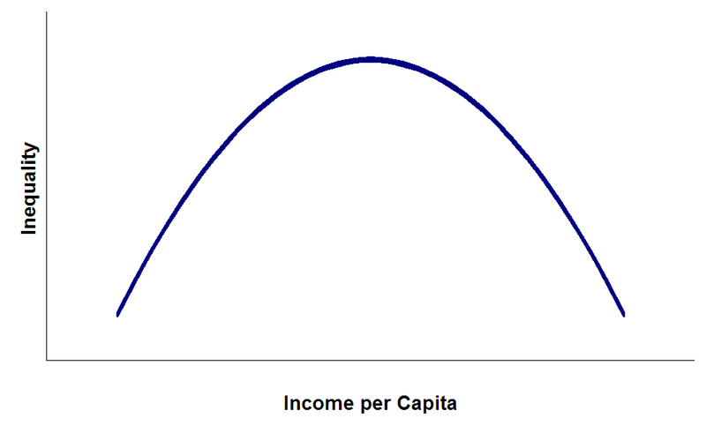
INTRODUCTION
Kuznets hypothesis:
Study based on times series data for England, Germany and US
Economic inequality increases up to a certain point and then declines as the income per capita increases.

Slide 4
INTRODUCTION
Recent studies: dominated by a cross section view.
Ahluwalia (1976b & 1979): estimated the relationship between development and inequality based on the data from 60 developing and developed countries.
Importance of Ahluwalia’s work depend on two main factors:
It confirms the U-hypothesis
It has been used by the World Bank for projections of inequality and poverty in World Development Reports (WDR).

Slide 5
INTRODUCTION
Anand and Kanbur investigates Ahluwalia’s findings in terms of their sensitivity to different functional forms and different data sets which are particularly important for projections.

Slide 6
AHLUWALIA’S FINDINGS
He used cross section data from 60 developing and developed countries including 6 socialist countries.
He ran 2 regressions; one for the full sample & one for a subsample of 40 developing countries
Regression equation:
I = index of ‘equality’: income share of the lowest 40% of the population
Y = GNP/cap
D = dummy for the socialists (D=1 if socialist)

Slide 7
AHLUWALIA’S FINDINGS
He found statistically significant coefficient estimates for logY and (logY)², which have the right signs generate the U-shape.
Problem: the positions of the curves of the full sample and the subsample are quite different ➔ $100 difference in turning points.

Slide 8
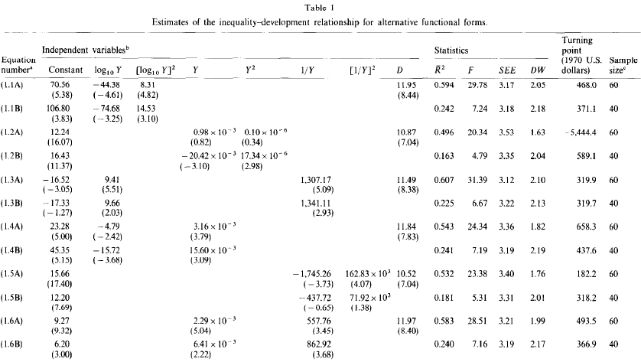

Slide 9
ALTERNATIVE FUNCTIONAL FORMS
Anand & Kanbur examine different functional forms in order to check for the sensitivity of Ahluwalia’s findings.
Economic theory: Kuznets process does not in general lead to a quadratic relationship between I and logY
They estimate 5 other functional forms that are capable of generating a U-shape.
‘A’ equations: full sample
‘B’ equations: restricted sample

Slide 10
ALTERNATIVE FUNCTIONAL FORMS
Eqn. 1.2A : significant coefficients, but does not support U-shape hypothesis.
Remaining ‘A’ equations: significant coefficients, support U-shape hypothesis, however, they have remarkably different turning points.
Prediction of the time path of the inequality differs depending on the functional form ➔ different projections of inequality for a given year

Slide 12
TESTING DIFFERENT FUNCTIONAL FORMS
All of the R²s are around 0.5 and F values are around 25
Durbin-Watson statistic does not pick any misspecification
How to choose the proper model?
Hypothesis testing procedure of Cox & Pesaran:
Test statistic = N₀
First: H₀: model 1, H₁: model 2
Second : H₀: model 2, H₁: model 1
If, model 1rejects model 2 in the first stage and model to cannot reject model 1 in the second ➔ model 1 dominates model 2

Slide 13
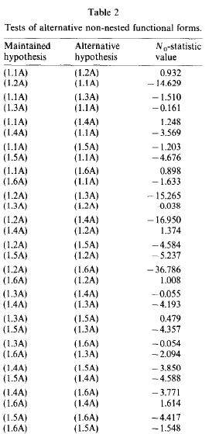
1.1A dominates 1.2A at 5% significance
0.93<1.96 & -14.6 < -1.96
It cannot dominate 1.3A & 1.6A
Data cannot discriminate between these two functional forms

Slide 14
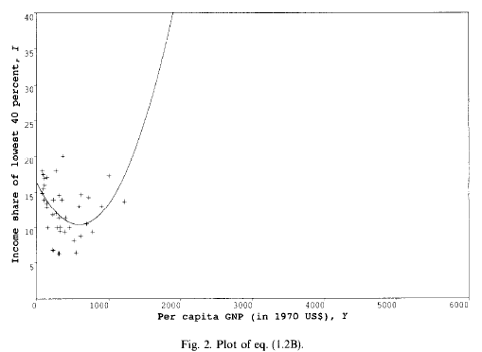
AN ECONOMETRIC PROBLEM
Predicted value of I can lie outside the range of [0, 40] %
Inconsistency between error term being normally distributed in the interval (∞, -∞) and dependent variable being restricted in [0, 40] interval
‘Limited dependent variable’

Slide 15
AN ECONOMETRIC PROBLEM
Remedy: logistic function;
Transform the dependent variable so as to keep the original I in the interval [0, 40].
The logistic and non-logistic curves of the equations 1.2B and 1.4B turns out to be very different (just reported)

Slide 16
INEQUALITY PROJECTION IN 2000
WDR 1978, 1979 & 1980 used Ahluwalia’s methodology.
Compare Ahluwalia’s model (1.1A) versus 1.3A : neither of which can dominate the other
Major discrepancies between the projections
Bangladesh: difference = 15% of their average value
Overall range of discrepancies relative to the average range of projections = 24.2%
Yugoslavia, Argentina and Venezuela: projections of income share are larger than 40%

Slide 17
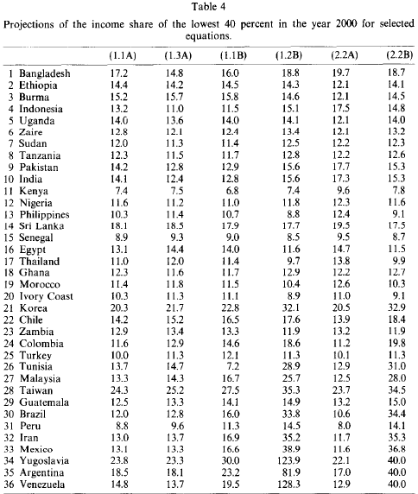

Slide 18
INEQUALITY PROJECTION IN 2000
Projections are highly sensitive to the functional form and the sample size used.

Slide 19
PROBLEMS WITH THE DATA
The source of the GNP/cap data is not cited
Income distribution data: either no source is cited or do not match the source
Ahluwalia uses free-hand method to obtain the estimates of quintile shares through the observed points of survey data on the fitted Lorenz curve without proper justification
makes it impossible to replicate his estimates by an independent researcher
He gives no proper justification for the countries chosen

Slide 20
PROBLEMS WITH THE DATA
Income distribution data for the countries he has chosen are not comparable with respect to income concept, population unit and survey coverage.
Remedy:
Anand & Kanbur constructed a data set for the same set of countries which is comparable in terms of income concept (HH income), population unit (HH) and survey coverage (national).
For 26 of the countries: no HH-National source is presented ➔ dropped (34 remaining)

Slide 21
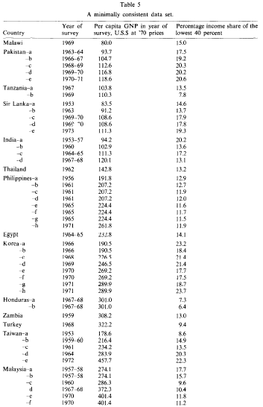
There are multiple figures of income distribution and GNP/cap for a given year for some countries.
They choose one observation for each country.

Slide 22
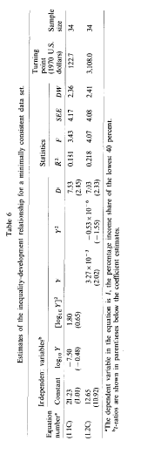
PROBLEMS WITH THE DATA
Model 1.1C : insignificant coefficients (except the dummy variable)
Implies a U-shape, but the turning point is considerably different from 1.1A ($468 vs. $122)

Slide 23
PROBLEMS WITH THE DATA
Model 1.2C : Y2 ➔ insignificant
Coefficients imply ‘reversal of U-shape’
According to non-nested hypothesis test: model 1.2C dominates 1.1C

Slide 24
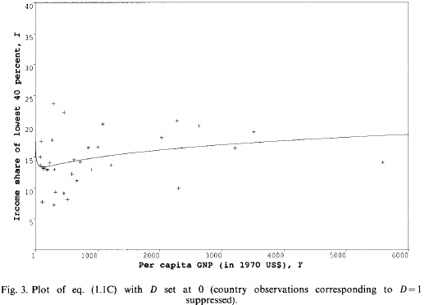

Slide 25
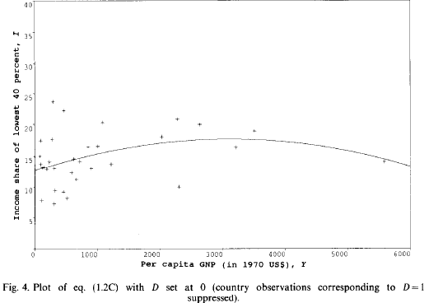

Slide 26
CONCLUSION
The estimates of Ahluwalia are highly sensitive to the functional form of the regression which has a considerable impact on the projections
The data set used by Ahluwalia is not properly justified and deficient
While log-quadratic form is rejected, the preferred form (GNP/cap instead of log version) displays reversal of the commonly accepted U-shape hypothesis.

